Slide 1
YOGI Reporting
10th June 2008

Slide 2
Contents
Objective
Scope
Methodology
IFS Non Stop Op Samples
Other Samples
Demo
Future

Slide 3
Objective
Build a Report Processor that would simplify generation of different types of Reports : -
  Simple Reports
  Group Reports
  Drill down Group Reports
  Fully Dated Reports (Groupings by Year, Month, DOW, Week, Quarterly etc)
  Compare Reports (for all the above categories of Reports)

Slide 4
Scope
Report Template
Report/Query Builder Interface
Report Processor
Data Loader
Report/Query Builder Interface
Data Store
Report Formatter
Report Viewer
Report Formatter
Report Viewer

Slide 5
Methodology

Slide 6
Reporting as part of An Application
Report Template
Report/Query Builder Interface
Report Processor
Application
Report/Query Builder Interface
Report Formatter
Report Viewer
Report Formatter
Report Viewer

Slide 7
Main Template Elements
Columns
Report Template
1 … *
Column
Selector
0 … 1
0 … 1
0 … 1
Column Comparator
Group Column
Comparator
Group
Column Selector
0 … 1
Group By
0 … *

Slide 8
Main Column Elements
Evaluator
Column
1
Function
0 … 1
Formatter
0 … 1
Comparator
0 … 1

Slide 9
Comparison to SQL
SQL - Query | YOGI - Reporting | Comments
Select c1, c2, c3, sum(c4) gc4, average(c5) gc5 | reportTemplate. addColumns(c1, c2 …) | Column has an evaluator that specifies how the column value is computed from the object, and an optional function that would be used for grouping, and an optional formatter that is used for converting the value to String, and an optional comparator to be used while comparing on this column.
From table1, table2 … | The Business objects that we are reporting on. | Joining is not needed separately in JRF as Business objects are already joined.
Where c1 = ‘xxx’ and c2 in (‘a’, ‘b’) … | reportTemplate. setSelector(selector) | Selector could be compound selector, which ands or ors multiple column selectors.
Order by c1, c2 … | reportTemplate. setComparator( columnComparator(c1, c2 ..) | Comparator specifies the order in which to sort the Business objects.
Group by c1, c2, c3 | reportTemplate. addGroupBy(groupBy) | Multiple GroupBy’s can be added to achieve drill -down capability.
Having gc4 > 100 and gc5 < 5 | reportTemplate. setGroupSelector(groupSelector) | Group selector helps in filtering the groups based on the group values.
 | reportTemplate. setGroupComparator( groupComparator) | Group Comparator specifies the sorting criteria for the groups.

Slide 10
Fully Dated Reports
Fully Dated reports can be generated by using :-
  Dated Columns like Month, Year, DayOfWeek etc.
  DatedGroupBy while grouping instead of groupBy. And will have to specify the Interval Evaluator (used to get the interval for a Business Object) to be used for the DatedGroupBy.

Slide 11
IFS Non Stop Op Samples

Slide 12
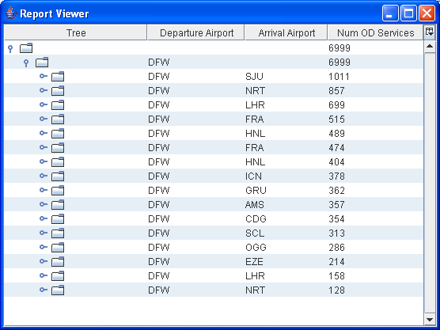
IFS NonStopOp Report
Sample 1

Slide 13
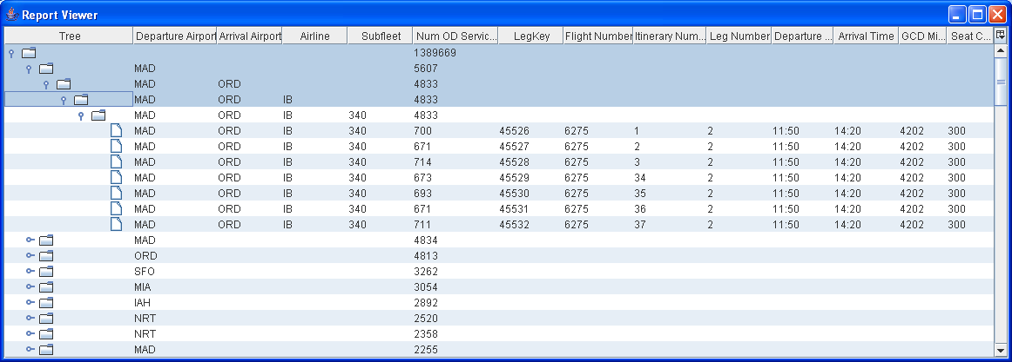
IFS NonStopOp Report
Sample 2 (expanded)

Slide 14
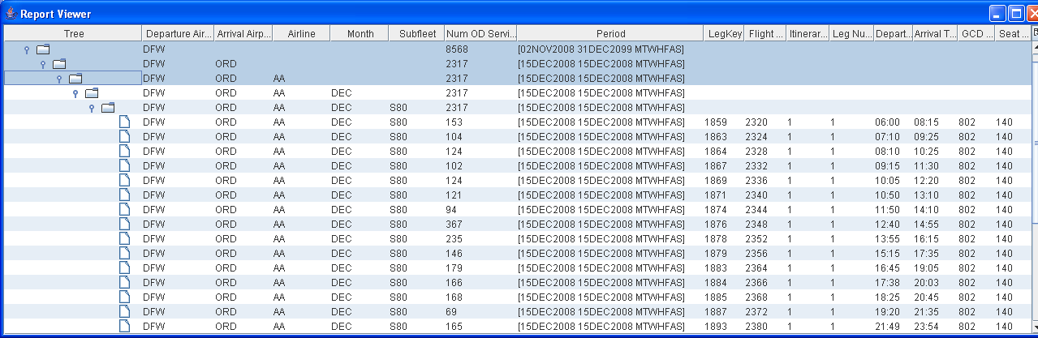
IFS NonStopOp Report
Sample 3 (Dated)

Slide 15
Other Samples

Slide 16
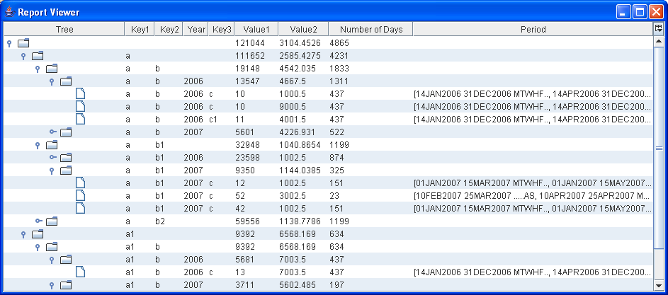
Dated Report Grouped By Year

Slide 17
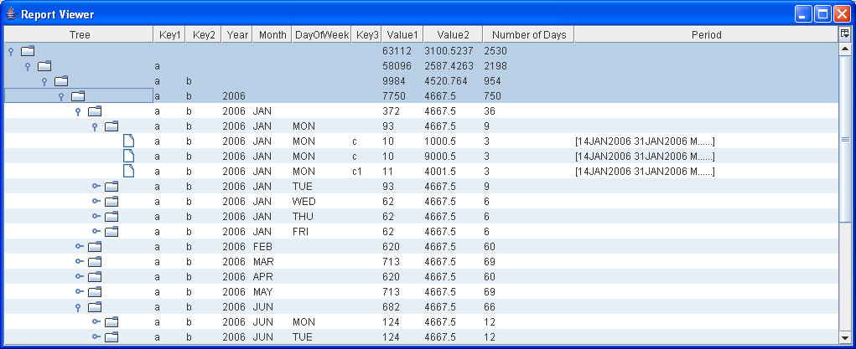
Dated Report Grouped By Year, Month, and Day of Week

Slide 18
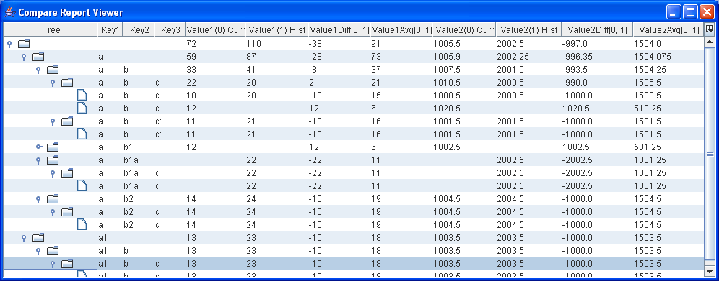
Compare Report

Slide 19
Sample Formatted Report
______________________________________________________________
Key1 | Key2 | Key3 | Value1 | Value2
______________________________________________________________
a | b | c | 10 | 1000.5
a | b | c1 | 11 | 1001.5
a | b1 | c | 12 | 1002.5
a | b2 | c | 14 | 1004.5
a1 | b | c | 13 | 1003.5
______________________________________________________________

Slide 20
Demo

Slide 21
Future

Slide 22
Report Query Builder Interface
Select Data Set
Select Columns
Filter
Sort
Group By
Group Filter
Group Sort
Compare
Save As
Save
Run

